Slide 1

Title: DNS (Domain Name System)
Course Name: Computer Networks.
Course Code: ICT-3201
Presented by:
Supervised by:
Name: Sahriar Ahmad Tarek
Dr. Nazrul Islam
Id: it-22047
Associate professor
3rd Year 2nd Semester
Dept. of ICT, MBSTU

Slide 2
Introduction to DNS:
Right now, as we sit here, billions of invisible conversations are happening across the internet. Every time someone types a web address, checks their email, or opens an app, there's a critical system working behind the scenes that makes it all possible. Today, I'm going to take you on a journey through one of the internet's most essential yet often overlooked technologies—the Domain Name System, or DNS
The Domain Name System, commonly known as DNS, is one of the fundamental protocols that makes the internet usable for everyday people. DNS serves as the internet's phonebook, translating human-readable domain names like google.com into machine-readable IP addresses like 142.250.190.46. Without DNS, we would need to memorize complex numerical addresses for every website we want to visit. This system operates behind the scenes every time you browse the web, send an email, or use any internet-connected application.

Slide 3

Why DNS Was Born
The Problem
The Solution
In the early 1980s, a single text file called HOSTS.TXT maintained all hostname-to-address mappings. As the internet exploded from hundreds to millions of computers, this centralized system became completely unmanageable.
Paul Mockapetris invented DNS in 1983. Its hierarchical, distributed design allows it to efficiently handle billions of domain names today—making it one of the most successful large-scale distributed systems ever created.

Slide 4
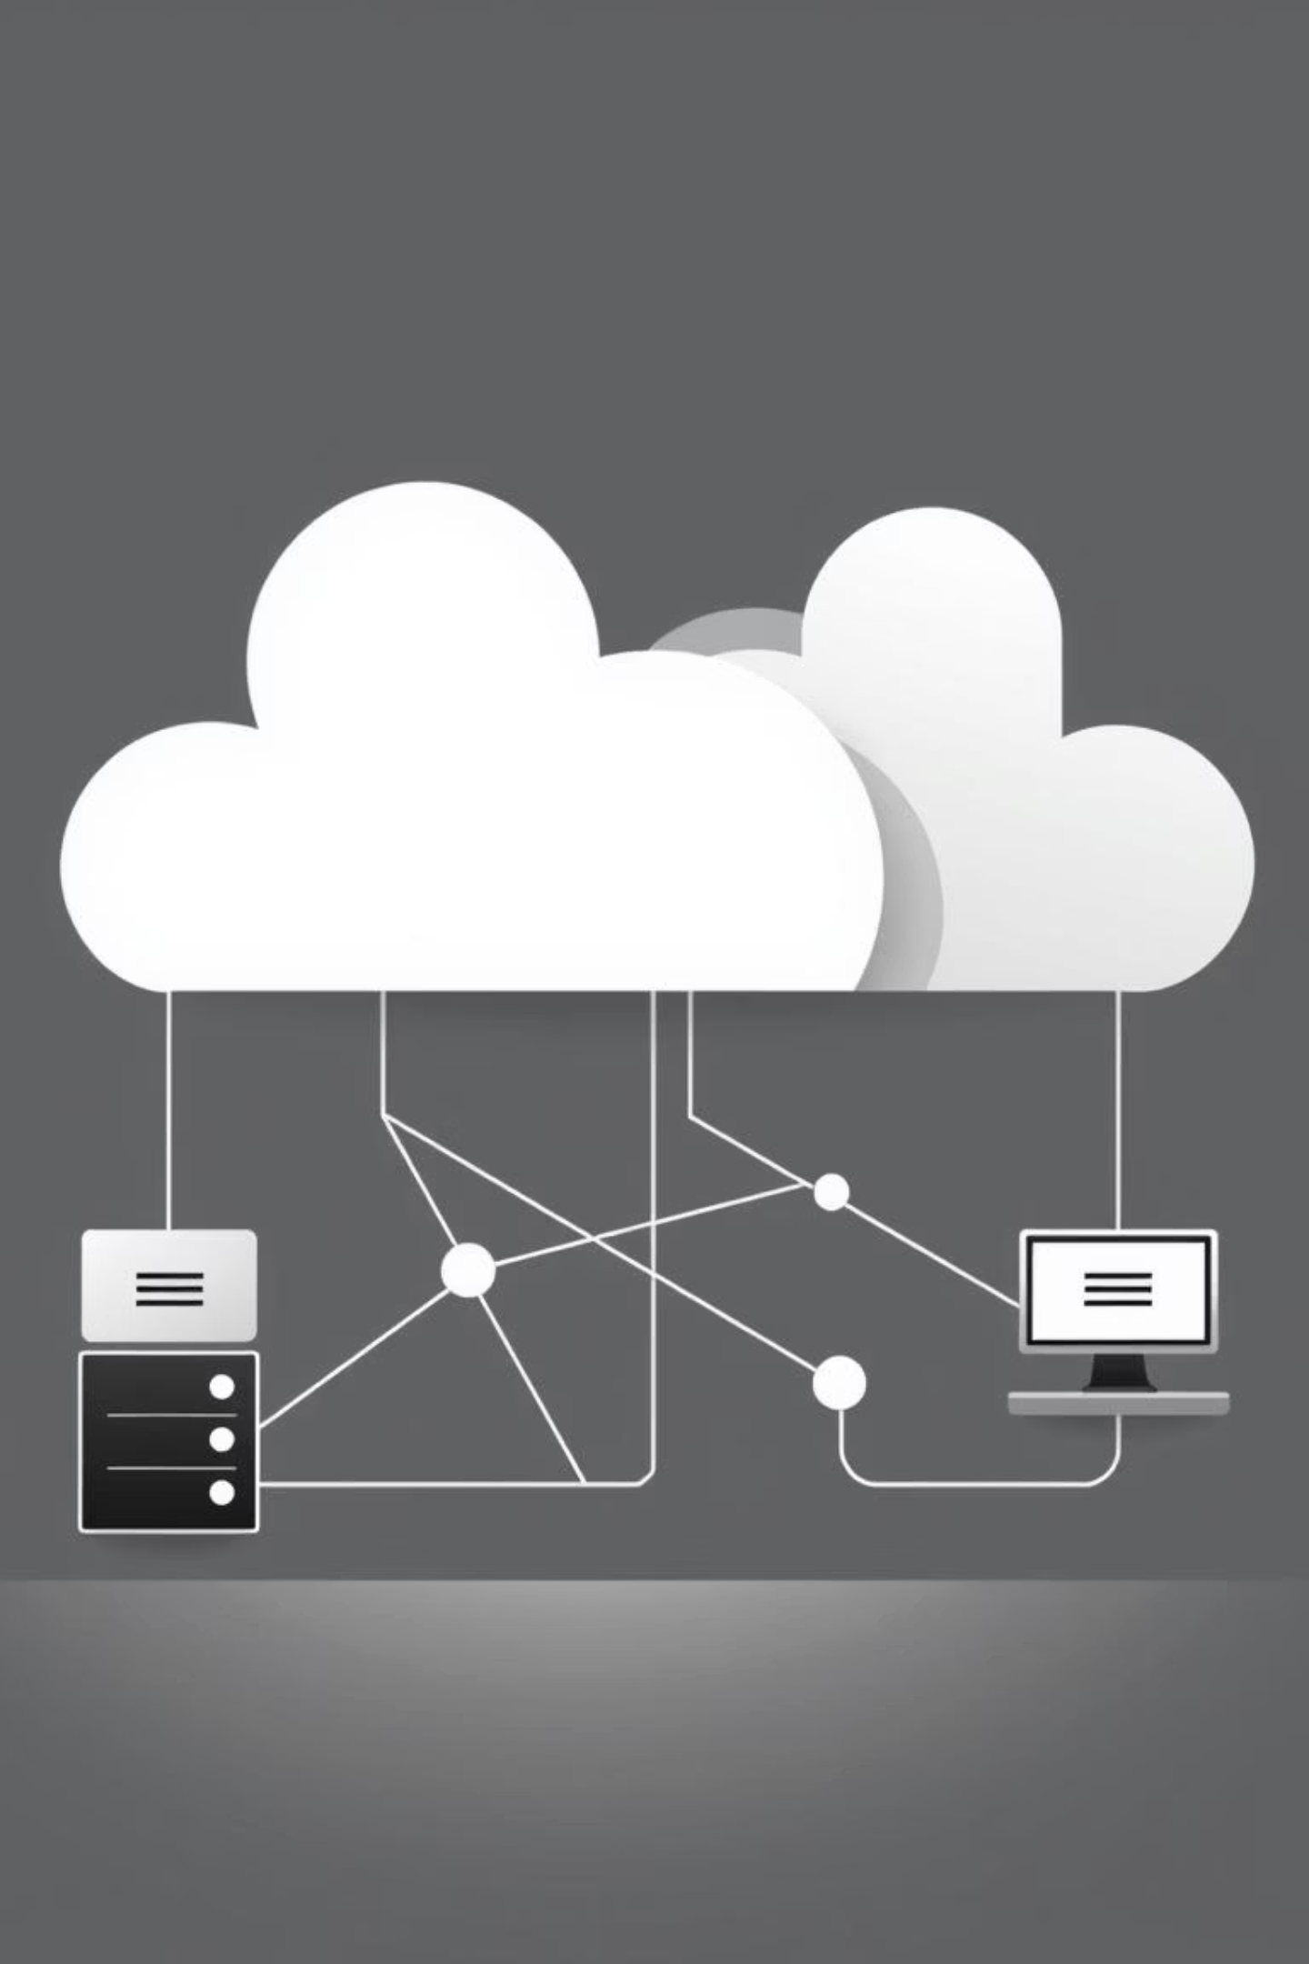
DNS Resolution: The Journey
When you type a URL, milliseconds of action unfold: your computer checks its cache, contacts a DNS resolver, which queries multiple servers hierarchically until finding the correct IP address. This elegant chain of lookups completes in under 100 milliseconds, billions of times daily across the globe.
01
Browser Cache Check
Local memory lookup
02
Recursive Resolver
ISP or third-party service
03
Root, TLD, Authoritative
Hierarchical server queries
04
IP Address Returned
Complete in milliseconds

Slide 5




The DNS Hierarchy
DNS organizes itself as an inverted tree, starting with the root domain at the top, managed by 13 global root server systems. Below sit Top-Level Domains (.com, .org, .uk), then second-level domains (google, amazon), and infinite subdomains beneath. This elegant structure distributes authority while enabling massive scalability.
1
Root
2
TLDs
3
Second-Level
4
Subdomains

Slide 6

Four DNS Server Types
Recursive Resolvers
Intermediaries between clients and servers, performing the heavy lifting to track down IP addresses
Root Nameservers
Direct queries to appropriate TLD servers; 13 systems distributed globally
TLD Nameservers
Manage specific top-level domains and point to authoritative nameservers
Authoritative Nameservers
Hold actual DNS records for specific domains and provide definitive answers

Slide 7
DNS Record Types Decoded
Record Type
Purpose
A
Maps domain names to IPv4 addresses
AAAA
Maps domain names to IPv6 addresses
MX
Specifies mail servers for email delivery
CNAME
Creates aliases pointing to other domains
TXT
Stores text information for authentication and verification
NS
Designates authoritative nameservers for a domain

Slide 8

Caching: The Speed Secret
How It Works
The Trade-off
DNS resolvers cache responses based on TTL values. Your OS, browser, and network devices all maintain caches, dramatically reducing repeat queries and accelerating website access.
DNS changes propagate slowly—typically minutes to 48 hours. Understanding TTL values is crucial for managing DNS updates effectively. Higher TTL improves performance but delays changes.

Slide 9


DNS Security Challenges
DNS was designed in a more trusting era and lacks built-in security features. DNS spoofing redirects users to malicious sites, cache poisoning injects false information, and amplification attacks exploit the protocol for devastating DDoS assaults. Unencrypted queries expose your browsing activity.
DNS Spoofing
False responses redirect users to malicious websites
Man-in-the-Middle
Attackers intercept and modify queries and responses
Amplification Attacks
DDoS exploits using DNS queries as weapons
Privacy Exposure
Unencrypted queries reveal browsing activity

Slide 10

Modern DNS: DNSSEC, DoH & DoT
DNSSEC (DNS Security Extension)
Cryptographic signatures ensure DNS authenticity and prevent tampering through digital verification
DoH & DoT
Encrypt DNS queries using HTTPS and TLS to shield your browsing activity from ISPs and network monitors
While adoption has been gradual, these protections are essential for modern security and privacy. Major browsers and operating systems now support encrypted DNS protocols, though debates continue about centralization concerns.

Slide 11



The Future of DNS
Emerging Tech
DNS over QUIC promises better performance and security
Scale Challenges
IoT growth strains infrastructure; IPv6 requires expanded support
Privacy Evolution
Regulations drive changes in DNS data collection and usage
Staying Relevant
DNS remains resilient and adaptable after 40+ years, foundational to internet connectivity

Slide 12

Thank You
Thank you very much. Are there any questions?
Questions?

